Slide 1


VARDHAMAN COLLEGE OF ENGINEERING, HYDERABAD Autonomous institute affiliated to JNTUH DEPARTMENT OF CSE(AI&ML)
SOIL QUALITY AND MANAGEMENT USING DEEP LEARNING AND INTERNET OF THINGS FOR PRECISION AGRICULTURE
BATCH ID : 64
S. No | Roll. No | Student Name
1 | 21881A66D2 | A RANJITH KUMAR
2 | 21881A66D3 | ABBA BHARADWAJ
3 | 22885A66E5 | S DHANUSH CHOWDHARY
Supervisor
Ms. Shaista Farhat
Assistant Professor, CSE (AI & ML)

Slide 2
Introduction
Soil quality is one of the most critical factors in determining crop yield, nutrient balance, and sustainable farming practices.
Traditional methods rely on manual soil testing and farmer’s intuition, which can be subjective, inconsistent, and often delayed.
Manual monitoring is labor-intensive, time-consuming, and not feasible for large-scale or continuous assessments.
IoT sensors enable real-time measurement of soil parameters such as pH, moisture, temperature, and nutrient content (NPK, etc.)
Objective of the Project
Use an Ensemble Model for classification soil quality for precision agriculture.

Slide 3
Problem Statement & Motivation
🔴 Problem Statement
Time-Consuming: Real-time Analysis is difficult and slow without automated systems.
Manual analysis is slow and error-prone.
Lack of real-time data affects productivity.
🔴 Motivation – Why Use AI?
Artificial Intelligence (AI) and deep learning enable fast and accurate sign language recognition:
✅ Automated & Real-time: No need for human experts.
✅ Affordable: cheap and easy for soil monitoring
✅ Scalability: AI can be deployed on mobile devices for accessibility.
✅ Improves decision-making and promotes sustainable agriculture.

Slide 4
LITERATURE REVIEW
Approach | Methodology | Advantages | Limitations
SCADA System | Telemetry using ADCON + MATLAB SCADA | Real-time monitoring, integration with existing automation systems | Low accuracy (34.34% error), lacks ML capabilities
Naive Bayes & KNN | Traditional ML on TNAU and Kaggle Farmer datasets | Simple to implement, fast execution | Low accuracy (~63.8%-68%), poor generalization, feature interaction not handled
LSTM & FRNN ( | Time-series analysis on VMC datasets using deep RNNs | Effective for sequential sensor data, captures temporal patterns | Computationally expensive, complex architecture
Hybrid Models (RF, SVM, NN) | Combination of multiple ML models on real-time data | Good accuracy (~82.3%), generalizes better with ensemble learning | Needs practical deployment validation

Slide 5
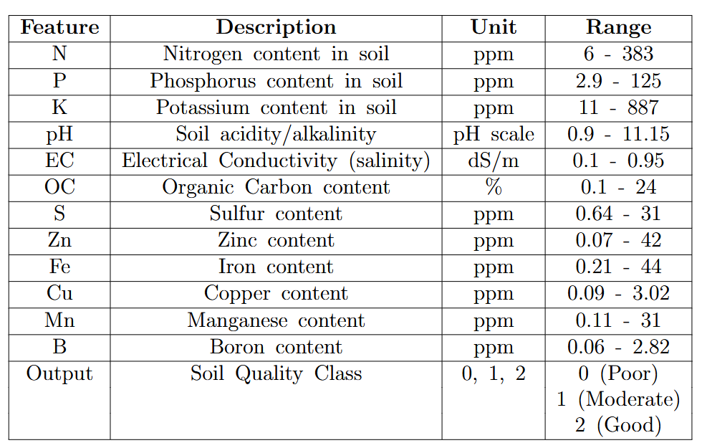
DATASET

Slide 6
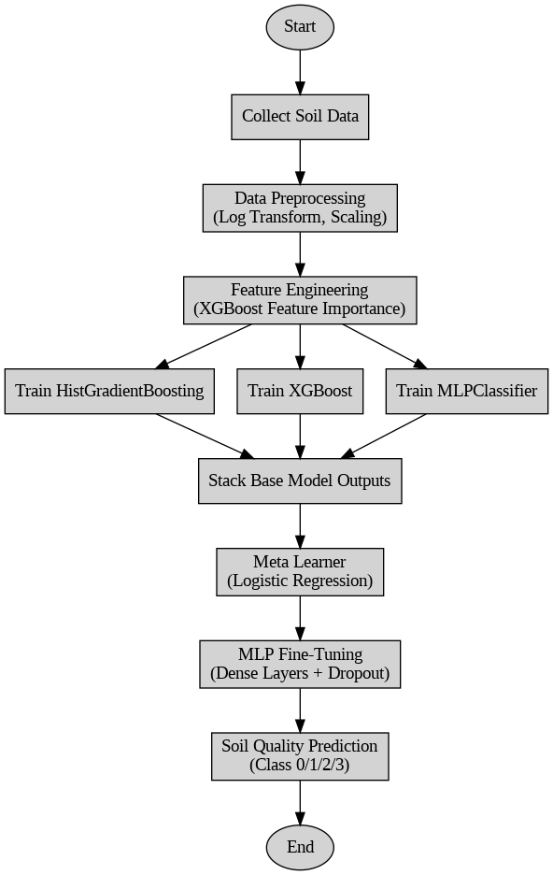
METHODOLOGY

Slide 7
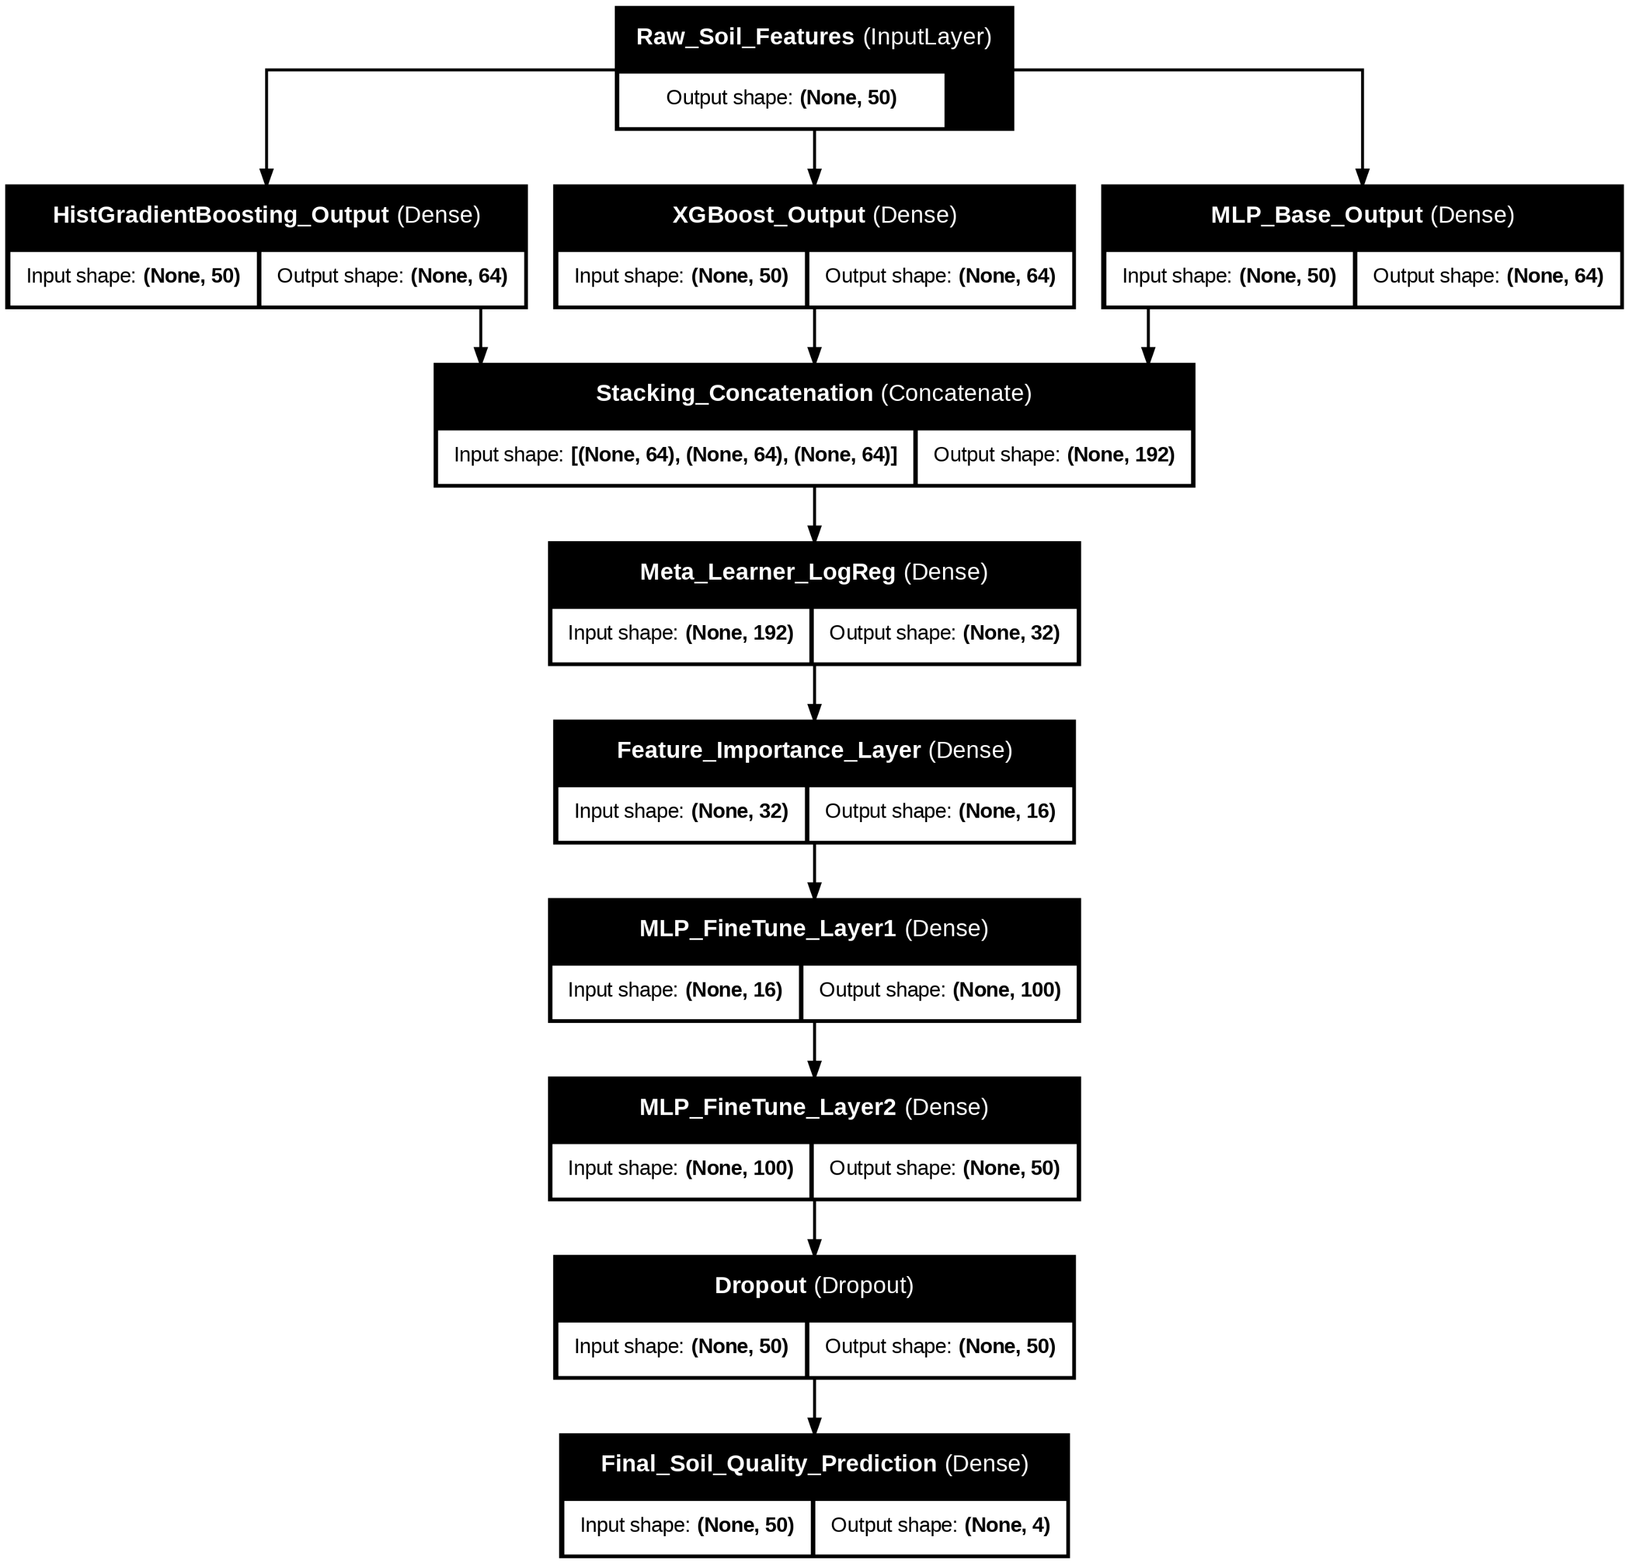
IMPLEMENTATION & EXECUTION
🖥️ Implementation Details
Software & Libraries Used:
Programming Language: Python
Frameworks: Flask
Additional Libraries: Pandas,scikit-learn,xgboost
Development Environment:
VS Code
Google Collab
Hardware Used:
CPU: Intel-based system (if GPU unavailable)
GPU: NVIDIA GPU (if available, speeds up training)
RAM: Minimum 8GB recommended

Slide 8
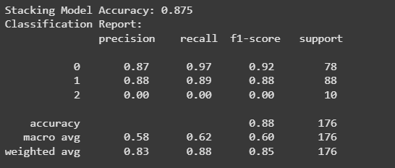
RESULT & ANALYSIS
Model Performance Metrics
Accuracy:87.5% with stacked ensemble model
Key features: pH, EC, N, P, K,OC

Slide 9

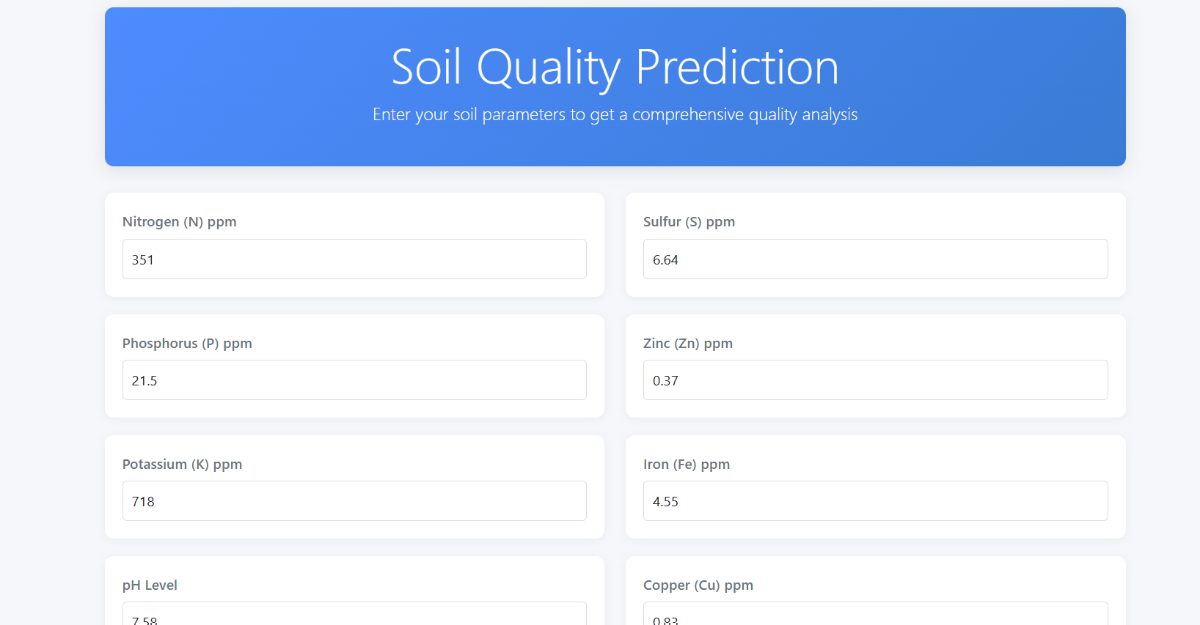
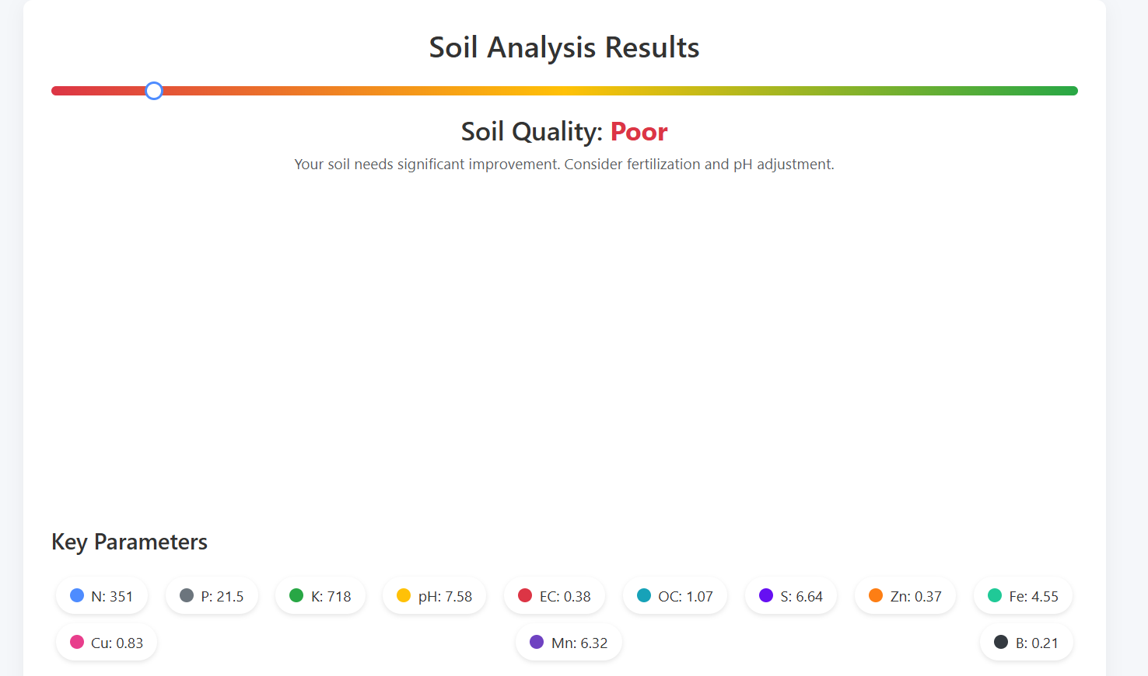
RESULT & ANALYSIS

Slide 10
CONCLUSION
DL + IoT improves soil monitoring.
Successfully implemented (HGB+MLP+XGBoost) model for
Ensemble model showed high accuracy and reliability.
Achieved high accuracy (88.9%) for real-time soil quality detection.
Future Work:
SMOTE, drone imaging, blockchain-based soil reports.
Expand to mobile/web app for farmer accessibility.

Slide 11
REFERENCES
[1] Gabriele Patrizi, Alessandro Bartolini, Lorenzo Ciani, Vincenzo Gallo, Paolo Sommella, and Marco Carrat` u. “A virtual soil moisture sensor for smart farming using deep learning”. In: IEEE Transactions on Instru mentation and Measurement 71 (2022), pp. 1–11.
[2] M Chandraprabha and Rajesh Kumar Dhanaraj. “Soil based prediction for crop yield using predictive analytics”. In: 2021 3rd international con ference on advances in computing, communication control and networking (ICAC3N). IEEE. 2021, pp. 265–270.
[3] D David Neels Ponkumar, Kolipaka Pushpa Krupa Himesh Kumar, S Ramesh, J Arun Kumar, G Nallasivan, and A Jayachandra. “Machine Learning Algorithm for Predicting Soil Classification using Smart Agri culture”. In: 2024 3rd International Conference on Sentiment Analysis and Deep Learning (ICSADL). IEEE. 2024, pp. 196–202.
[4] Farooq Anwar, Sajid Latif, Muhammad Ashraf, and Anwarul Hassan Gilani. “Moringa oleifera: a food plant with multiple medicinal uses”. In: Phytotherapy Research: An International Journal Devoted to Pharmaco logical and Toxicological Evaluation of Natural Product Derivatives 21.1 (2007), pp. 17–25
[5] Rahul Katarya, Ashutosh Raturi, Abhinav Mehndiratta, and Abhinav Thapper. “Impact of machine learning techniques in precision agricul ture”. In: 2020 3rd International Conference on Emerging Technologies in Computer Engineering: Machine Learning and Internet of Things (ICETCE). IEEE. 2020, pp. 1–6.
[6] S Venkatachalam, P Kavitha, Pradnya Kirankumar Ingle, G Ramachan dran, R Sasikala, and T Muthumanickam. “Analysis of Internet of Things Based Agriculture Fertilizer Nutrient Management Soil Health Irrigation System and its Applications”. In: 2024 2nd International Conference on Intelligent Data Communication Technologies and Internet of Things (IDCIoT). IEEE. 2024, pp. 64–69.

Slide 12


